Slide 1
Interactive GSSP App
Chris McVickar

Slide 2
Overview
Result of 10-week REU internship
Focused on time ontology, RDF databases, and designing applications in R
Two main pages
GSSP Marker Map – users visit GSSPs on a map and read information about them
GPlates Reconstruction Map – uses the GPlates API to reconstruct coastlines of Earth and calculate GSSP paleo-geographic coordinates

Slide 3
GSSP Marker Map, UI
Zoom in/out – click the ‘+’ and ‘-’ icons or scroll up/down while hovering the mouse over the map
Click and drag the map with the mouse to navigate around
Each marker represents the GSSP at its location
Click on each marker to open a popup window with additional information from the DTKB (press ‘X’ or click away to close)

Slide 4
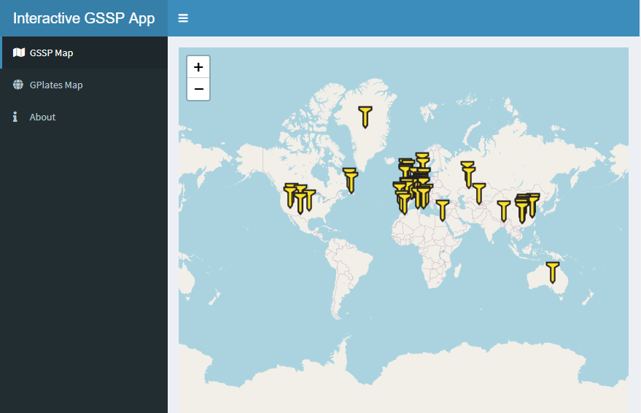

Slide 5
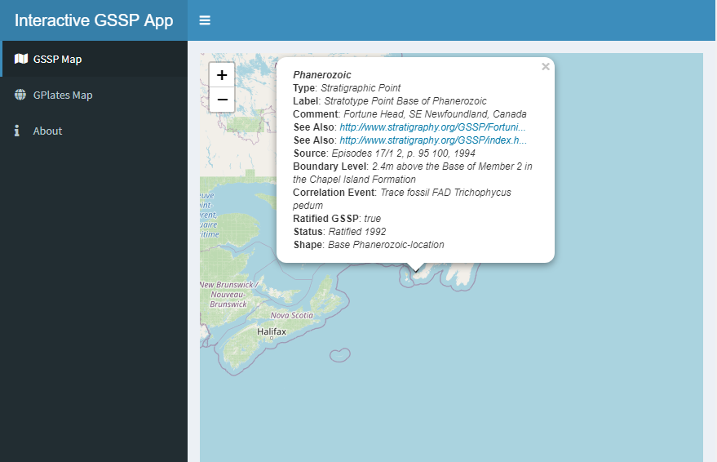

Slide 6
GSSP Marker Map, Server
Send SPARQL query to collect data
Process data
Construct map

Slide 7
GSSP Marker Map, Server: SPARQL
First query finds the most recent international scheme
Second query finds all GSSPs in that scheme as well as all their properties
This information is queried from the DTKB

Slide 8
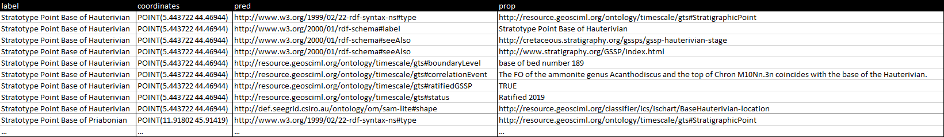
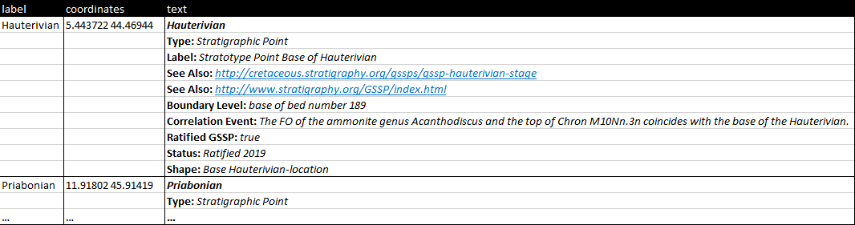
GSSP Marker Map, Server: Data Processing

Slide 9
GSSP Marker Map, Server: Leaflet Map
Map is constructed from processed data
Markers are placed at each GSSP’s coordinates with a golden spike icon
Markers display the HTML popup text

Slide 10
GPlates Reconstruction Map
Uses the GPlates Web Service to construct a map of Earth at the selected GSSP’s lower bound
The paleo-geographic coordinates of the GSSP at the lower bound are calculated and marked on screen

Slide 11
GPlates Reconstruction Map, UI
User selects GSSP from dropdown menu
Map is constructed
Controls are the same as the GSSP Marker Map
Clicking on the marker will open a popup window with the GSSP’s coordinates and lower bound

Slide 12
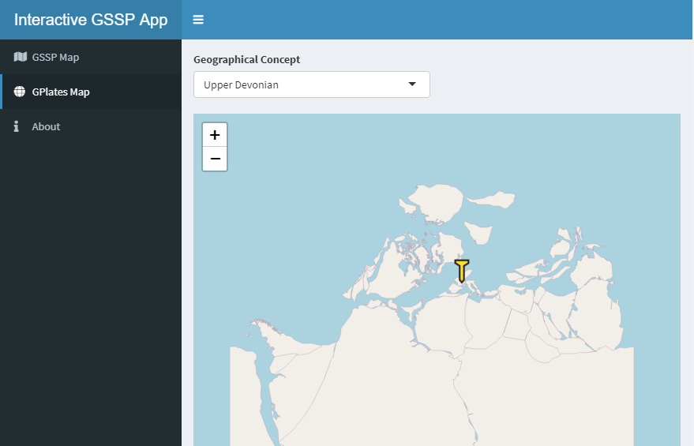

Slide 13
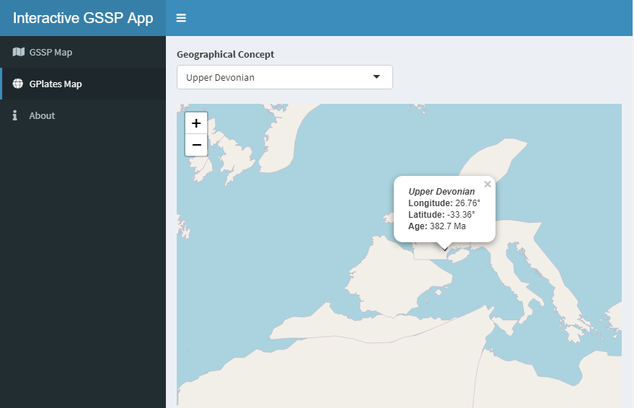

Slide 14
GPlates Reconstruction Map, Server
Collect information from SPARQL query, process it
User selects GSSP
Collect information from GPlates Web Service
Construct map

Slide 15
GPlates Reconstruction Map, Server: SPARQL
Find the most recent international scheme
Find all GSSPs, their coordinates, and their lower bounds in the scheme

Slide 16


GPlates Reconstruction Map, Server: SPARQL

Slide 17
GPlates Reconstruction Map, Server: GWS
Make coastline URL
Make coordinate calculation URL
Variables
time = lower bound of selected GSSP
model = “PALEOMAP” (range covers all GSSPs)
longitude and latitude = coordinates of the selected GSSP

Slide 18
GPlates Reconstruction Map, Server: GWS
https://gws.gplates.org/reconstruct/reconstruct_points/?points=longitude,latitude&time=time&model=model
https://gws.gplates.org/reconstruct/coastlines/?time=time&model=model

Slide 19
GPlates Reconstruction Map, Server: Leaflet Map
Read JSON from the URLs
Parse coordinates out of coordinate JSON
Create Leaflet map using coastline JSON
Add a marker with the parsed coordinates

Slide 20
Source Code
https://github.com/lotkey/Interactive-GSSP-App

